Slide 1

Computer Organization and Architecture Week 4

Slide 2
Clock Speed and Instructions Per Second
Operations performed by a processor, such as fetching an instruction, decoding the instruction, performing an arithmetic operation, and so on, are governed by a system clock.
Typically, all operations begin with the pulse of the clock. Thus, at the most fundamental level, the speed of a processor is dictated by the pulse frequency produced by the clock, measured in cycles per second, or Hertz (Hz).
Notes:
.

Slide 3
Common Prefixed Units / Frequency
Value | Symbol | Name | Amount
10² | Hz | hertz | cycles per second
10³ Hz | kHz | kilohertz | 1,000
10⁶ Hz | MHz | megahertz | 1,000,000
10⁹ Hz | GHz | gigahertz | 1,000,000,000
10¹² Hz | THz | Terahertz | 1,000,000,000,000
10¹⁵ Hz | PHz | petahertz | 1,000,000,000,000,000

Slide 4
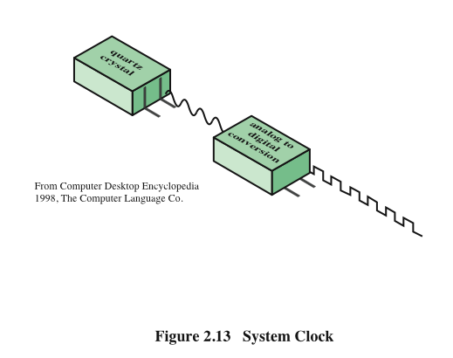
System Clock
Typically, clock signals are generated by a quartz crystal, which generates a constant signal wave while power is applied. This wave is converted into a digital voltage pulse stream that is provided in a constant flow to the processor circuitry

Slide 5
System Clock
For example, a 1-GHz processor receives 1 billion pulses per second.
The rate of pulses is known as the clock rate, or clock speed. One increment, or pulse, of the clock is referred to as a clock cycle, or a clock tick. The time between pulses is the cycle time.

Slide 6
System Clock
The execution of an instruction involves a number of discrete steps, such as fetching the instruction from memory, decoding the various portions of the instruction, loading and storing data, and performing arithmetic and logical operations.
Thus, most instructions on most processors require multiple clock cycles to complete. Some instructions may take only a few cycles, while others require dozens.

Slide 7
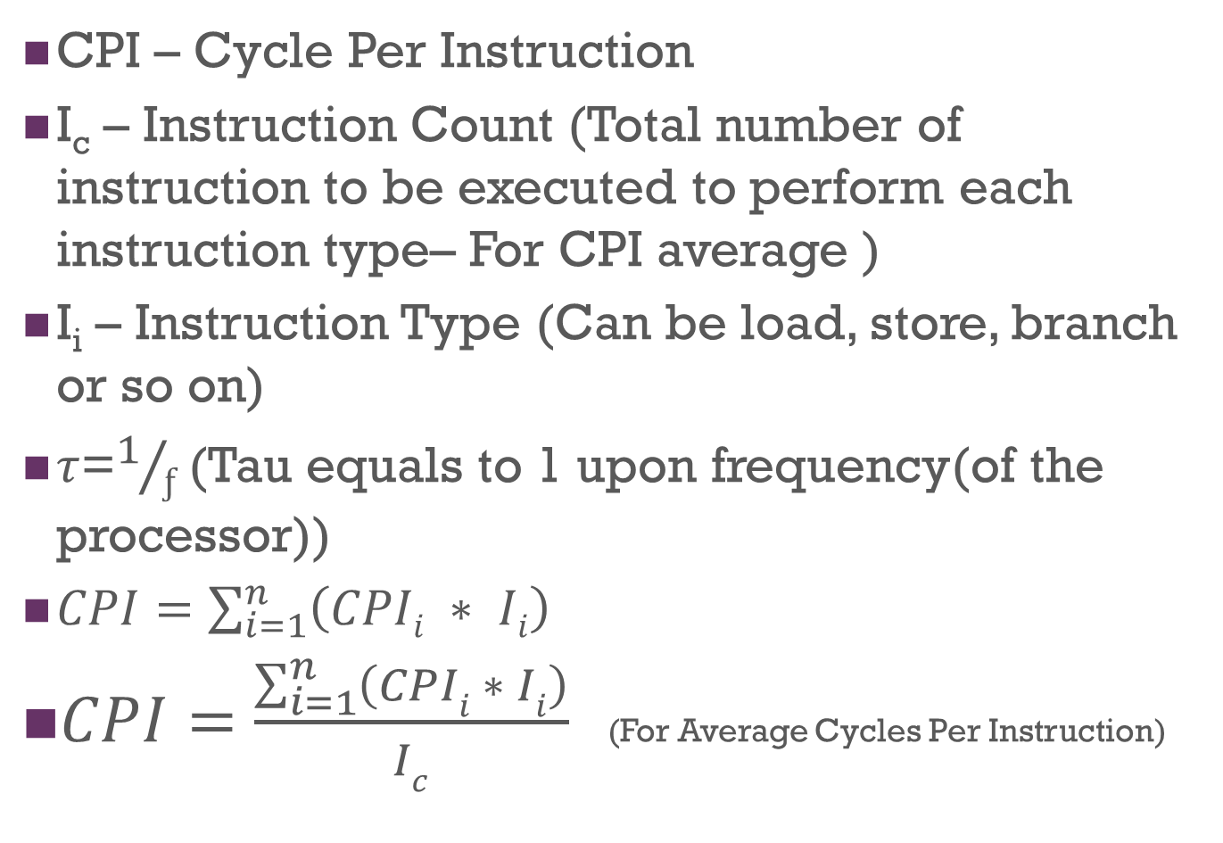
Terminologies

Slide 8
Cycles Per Instruction (CPI)
Suppose there are 3 types of instructions e.g. Addition, Subtraction and Multiplication.
CPI_{i} be the number of cycles required for instruction type i
I_{i} be the number of executed instructions of type i for given program

Slide 9
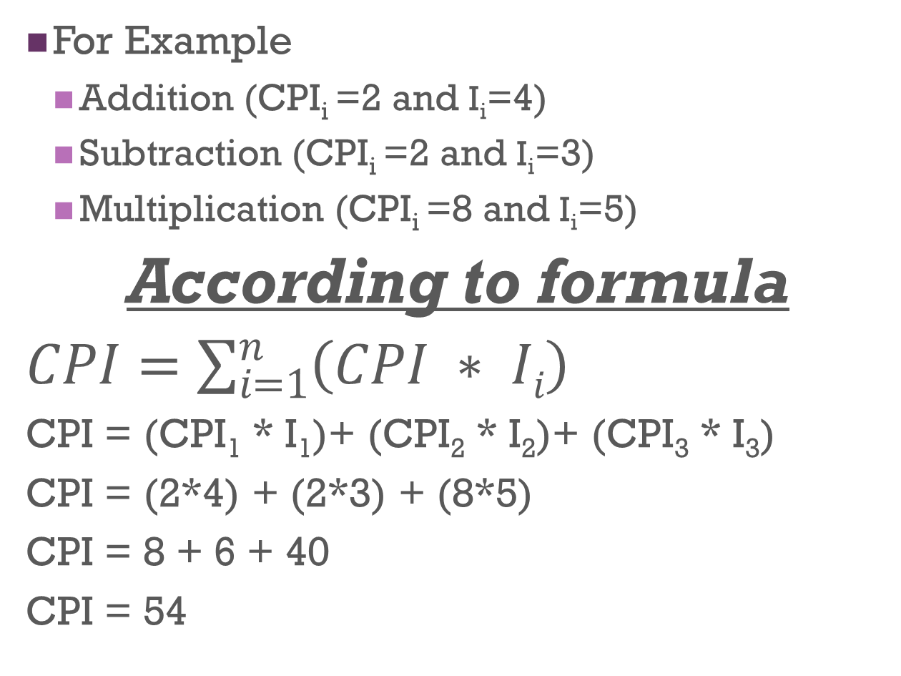
Cycles Per Instruction (CPI)

Slide 10
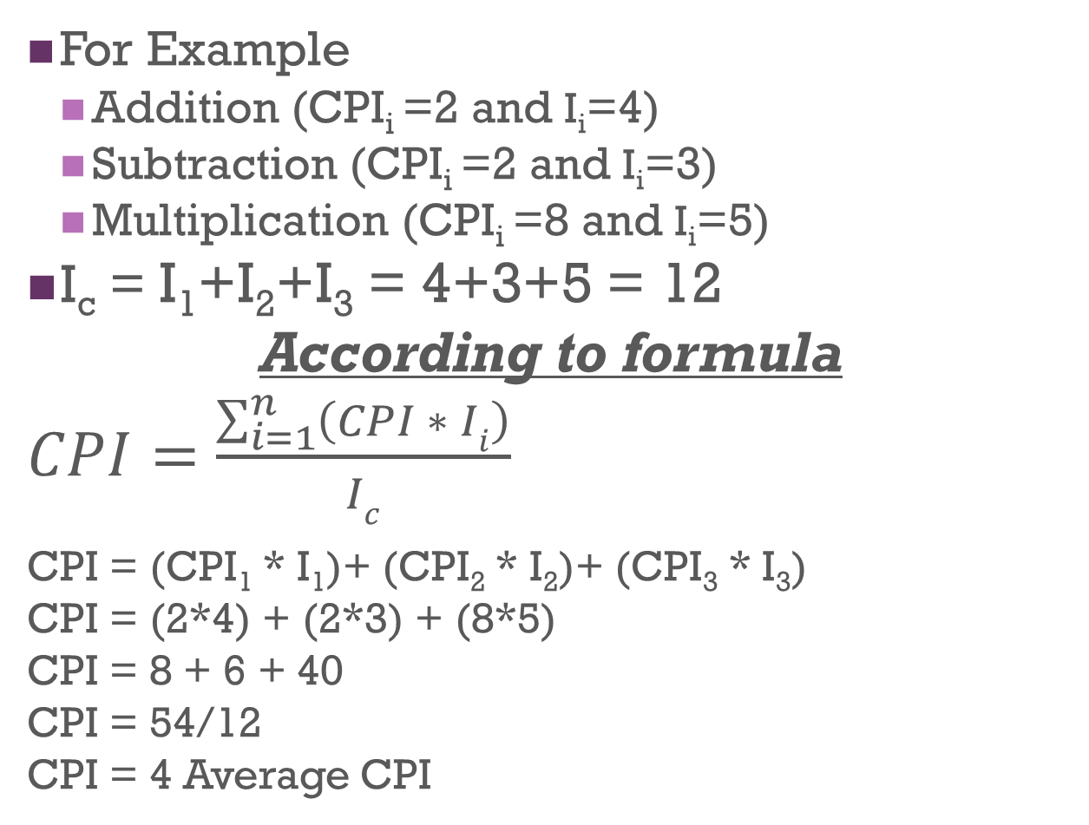
Average Cycles Per Instruction (CPI)

Slide 11
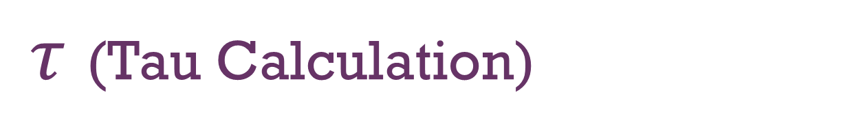
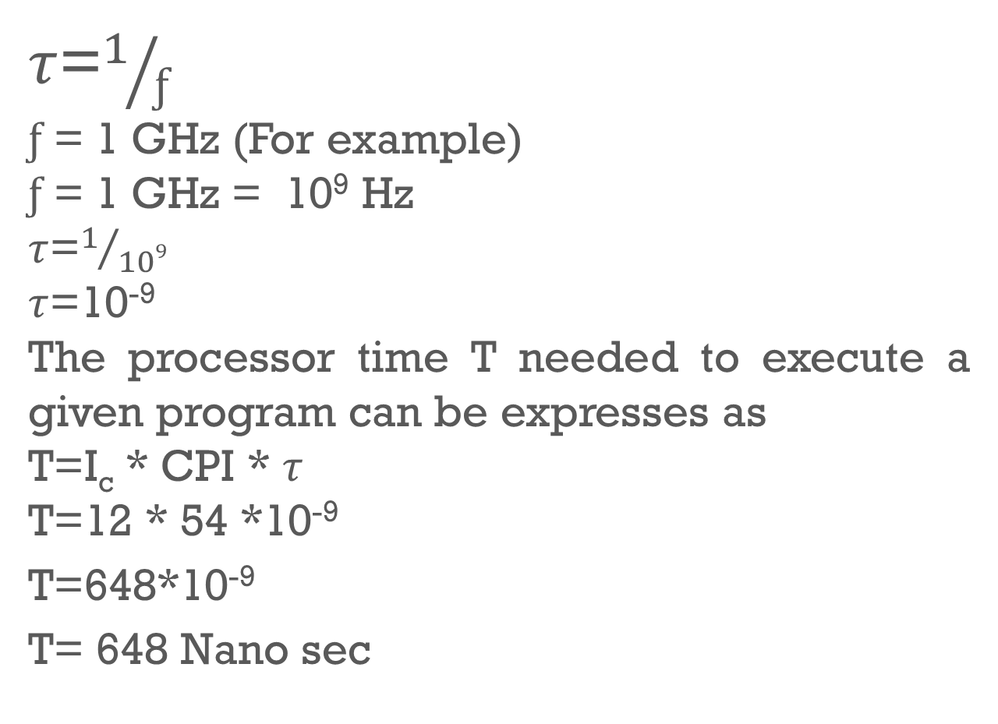
Measurement
10⁻³ Millie Sec
10⁻⁶ Micro Sec
10⁻⁹ Nano Sec
10⁻¹² Pico Sec

Slide 12
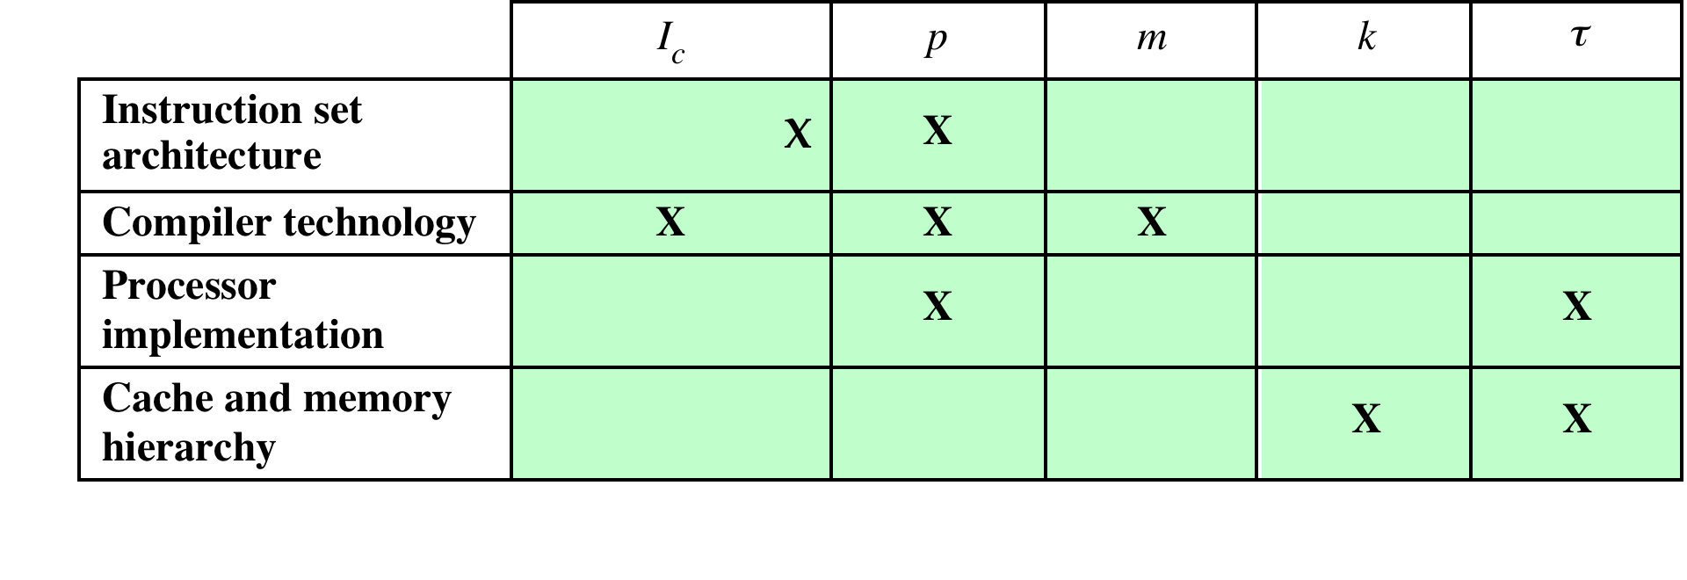
Five Performance Factors are influenced by Four System Attributes
p =Number of processors
m =Number of memory references
k = ratio between memory cycle time and processor cycle time
A common measure of performance for a processor is the rate at which instructions are executed, expressed as millions of instructions per second (MIPS), referred to as the MIPS rate.

Slide 13
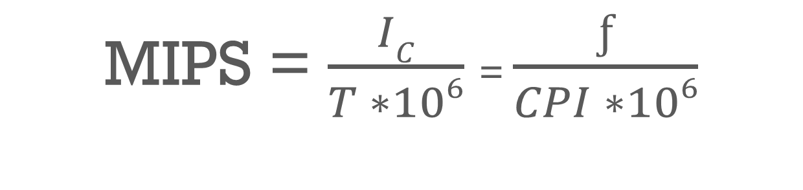
MIPS (Millions of Instructions Per Second)

Slide 14
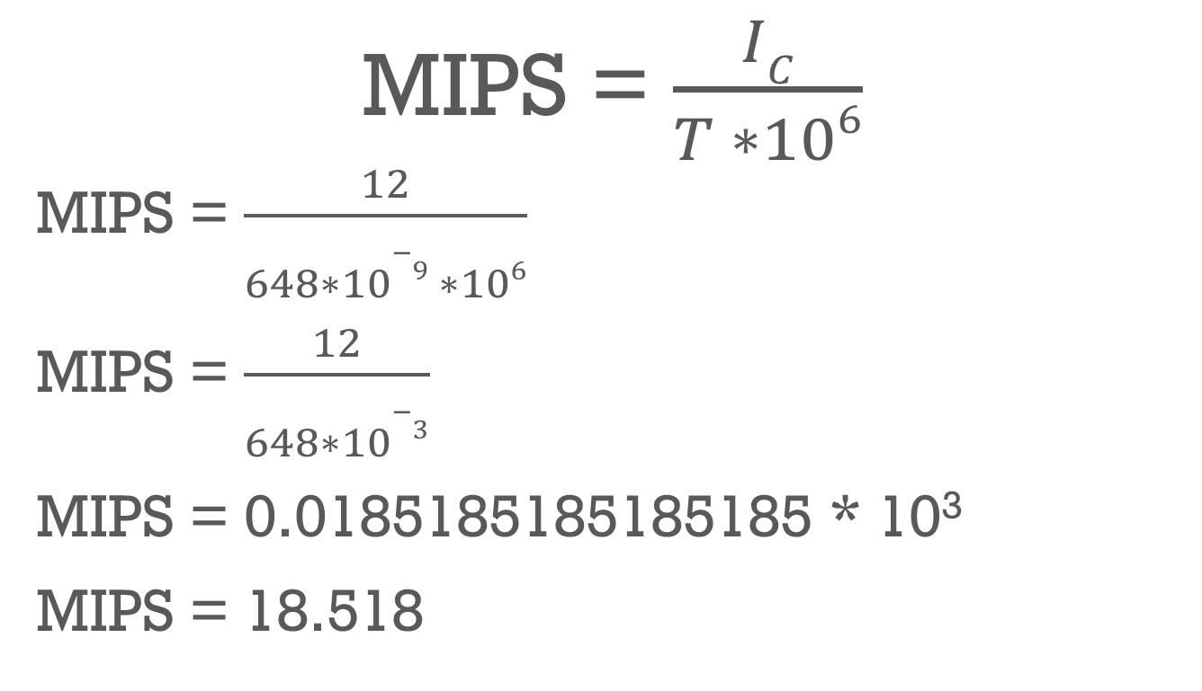
MIPS (Millions of Instructions Per Second)

Slide 15
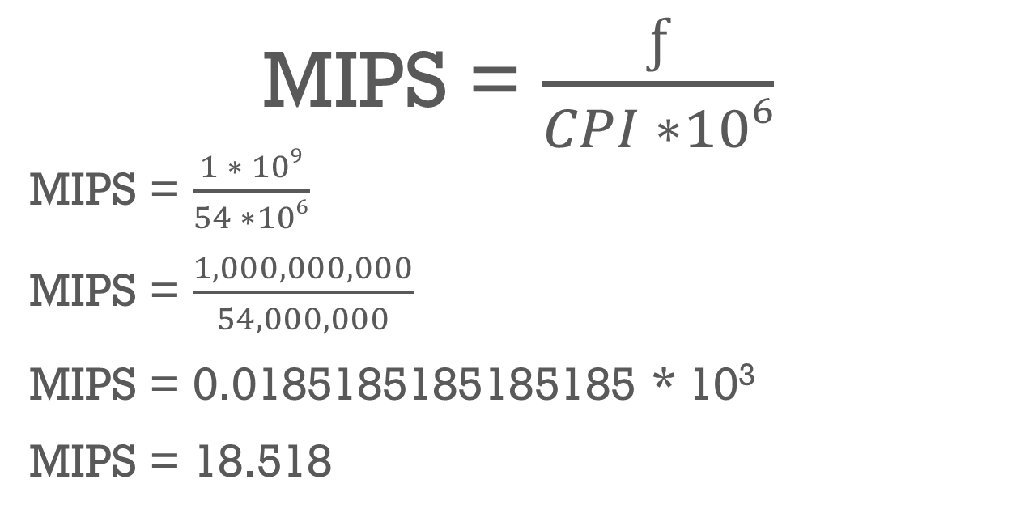
MIPS (Millions of Instructions Per Second)

Slide 16
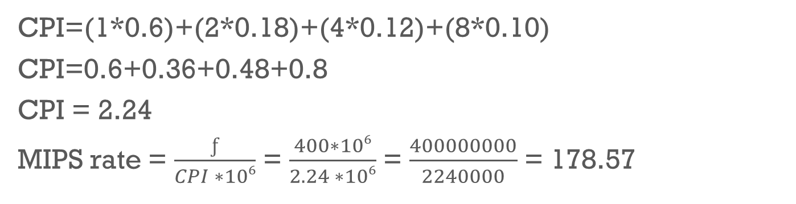
Another Example
Consider the execution of a program that results in the execution of 2 million instructions on a 400-MHz processor. The Instruction types are given below.
Instruction Type | CPI | Instruction Mix (%)
Arithmetic and Logic | 1 | 60
Load/store with cache hit | 2 | 18
Branch | 4 | 12
Memory reference with cache miss | 8 | 10

Slide 17
Exercise
Instruction Type | Instruction Count | Cycles per Instructions
Integer Arithmetic | 45000 | 1
Data Transfer | 32000 | 2
Floating Point | 15000 | 2
Control Transfer | 8000 | 2
A program is run on a 40 MHz Processor.
Determine the CPI and MIPS rate

Slide 18
Benchmarks
For example, consider this high-level language statement:
A = B + C /* assume all quantities in main memory */
With a traditional instruction set architecture, referred to as a complex instruction set computer (CISC), this instruction can be compiled into one processor instruction:
add mem(B), mem(C), mem (A)
On a typical RISC machine, the compilation would look something like this:
load mem(B), reg(1);
load mem(C), reg(2);
add reg(1), reg(2), reg(3);
store reg(3), mem (A)

